Slide 1
LG BOOSTING ALGORITHM
MACHINE LEARNING

Slide 2



LG Boosting
LightGBM (Light Gradient Boosting Machine) is a fast, high-performance boosting algorithm used for classification and regression.
Same like XGBoost, but it's designed to be faster, more efficient, and handle large datasets better.
LightGBM builds decision trees step-by-step, where each new tree tries to correct the mistakes of the previous one in a very smart and optimized way.

Slide 3
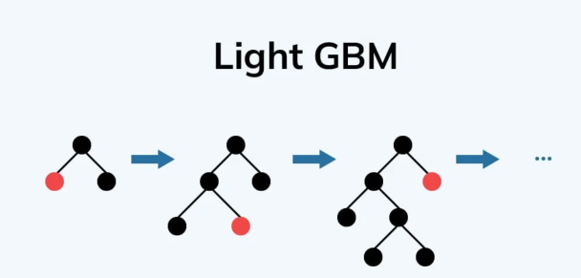
Light GBM Algorithm
Very High Speed
High Accuracy
Handles Big Dataset
In-Built Categorial Data
Leaf wise Growth

Slide 4
PROS
Very fast training
High accuracy
Works with large datasets
Handles categorical features directly
Low memory usage
CONS
May overfit on small data
Harder to tune for beginners
Can be sensitive to data preprocessing

Slide 5
Applications of LG Boosting
Medical Cost Prediction
Helps insurance companies decide premium amounts.
Assists hospitals in budgeting and resource planning.
Useful for patients to plan finances.
Handles large dataset.
Automatically deals with categorical features.
Can capture complex relationships between features.

Slide 6
Install a Library
!pip install lightgbm
PROCEDURE
import lightgbm as lgb
train_data = lgb.Dataset(X_train, label=Y_train)
regressor = lgb.train(params, train_data, num_boost_round=100)
Regressor.fit(X_train, Y_train)
lgb.train() is the native high-performance API
It requires a lgb.Dataset for:
Speed & Categorical optimization
Efficient memory layout

